Slide 1
Database system
Saba Ghani
FAST-NU
Chiniot Faisalabad Campus

Slide 2




Nested Queries
Some SQL statements can have a SELECT embedded within them.
A sub select can be used in WHERE and HAVING clauses of an outer SELECT, where it is called a nested query or a subquery.
Who has a salary greater than Abel’s?
Main query:
Which employees have salaries greater than Abel’s salary?
What is Abel’s salary?

Slide 3
SELECT select_list
FROM table
WHERE expr operator
(SELECT select_list
FROM table);
The subquery (inner query) executes once before the main query (outer query).
The result of the subquery is used by the main query.
Example.
SELECT last_name
FROM employees
WHERE salary >
(SELECT salary
FROM employees
WHERE last_name = 'Abel');

Slide 4
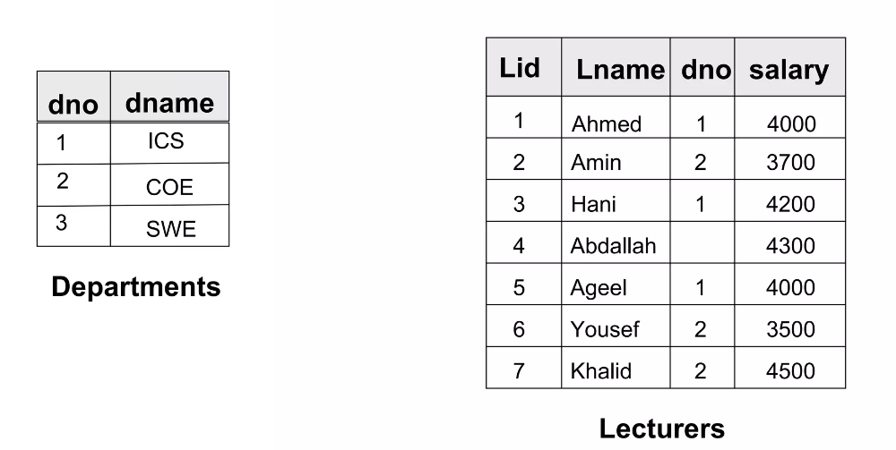
Example tables

Slide 5
Nested queries
From the Lecturer table, select lecturers whose salary is above average
Cannot write 'WHERE salary > avg(salary);
Solution
Select * from lecturer where salary>( select AVG(salary) from lecturer);
List the names of all Lecturers who are in the ICS department
select name from lecturer
where dno =(
select dno from department
where dname=‘ICS’);

Slide 6
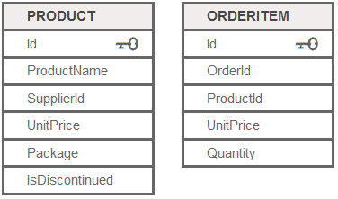
Nested queries
List products with order quantities greater than 100
select ProductName from PRODUCT
where id=( select id from ORDERITEM
where quantity>100);

Slide 7
Nested queries
Find lecturers whose salary higher than the salary of at least 1 COE lecturer.
Select * from lecturer
Where salary>(
select min(salary)
from lecturer where dno = (
select DNO
from department
where dname=‘COE’)
);

Slide 8
Nested queries
Find lecturers whose salary higher than the salary of every COE lecturer
Select * from lecturer
Where salary>( select max(salary
from lecturer where dno =(select DNO
from department
where dname=‘COE’);
);

Slide 9
Special Operators - EXISTS
Boolean functions that return TRUE or FALSE; hence, they can be used in a WHERE clause condition.
The EXISTS function in SQL is used to check whether the result of a nested query is empty (contains no tuples) or not. The result of EXISTS is a Boolean value TRUE if the nested query result contains at least one tuple, or FALSE if the nested query result contains no tuples.
Used to check if subquery returns any rows
Syntax
SELECT COLUMN(S) FROM Table-name WHERE EXISTS ( subquery );

Slide 10
Exists example
Find all ICS lecturer
SELCT * FROM LECTURER WHERE EXISTS(
SELECT * FROM DEPARTMENT
WHERE LECTUREER.Dno=DEPARTMENT.Dnumber AND DNAME=‘ICS’);

Slide 11
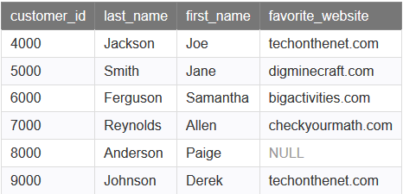
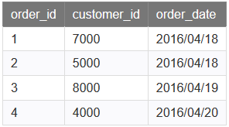
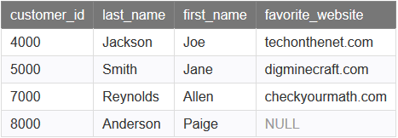
find all of the records from the customers table where there is at least one record in the orders table with the same customer_id.
SOLUTION
SELECT * FROM customers
WHERE EXISTS (
SELECT * FROM orders
WHERE customers.customer_id = orders.customer_id);

Slide 12
Home task
NOT EXISTS Operator

Slide 13
NOT EXISTS Operators
Query: List first and last name of employees who work on ALL projects NOT controlled by Dno=5.
SELECT Fname, Lname FROM Employee WHERE NOT EXISTS ( (SELECT Pnumber FROM PROJECT WHERE Dno=5)) ;
Find all non ICS lecturers.
SELECT *
FROM lecturers a
WHERE NOT EXISTS
(
SELECT *
FROM department b
WHERE a.dno = b.dno
AND b.dname = ‘ICS‘
);

Slide 14

Not Exists
SELECT * FROM customers
WHERE NOT EXISTS (SELECT * FROM orders WHERE customers.customer_id = orders.customer_id);

Slide 15
Not Exists
Find the record of all those customer who doesn’t place any
order

Slide 16
Aliasing Table Names
A table alias is created by directly placing an alias after the table name in the FROM clause.
For example, in the following example we will refer to departments table as d or dept.
SELECT d.dname
FROM departments d
WHERE d.dno = 1;
SELECT dept.dname
FROM departments dept
WHERE dept.dno = 1;

